Slide 1
Innovative Algorithms for the Astronomical Image Restoration
Lu Yi 121090386 Li Junxi 120090124
Motivation: In Astrophotography, the object we shoot is a very dim celestial body in the universe, whose light signal may not be much stronger than the noise. However, astronomy images with high resolution are critical for the scientific research, and we can often only get images with noise at the first place. As a result, we aim to preprocess the deep space image to remove the noise and get images with better quality.

Slide 2
Goal and Methodology
Goal: Our goal is to design some innovative algorithms to overcome some of those limitations and output better processed images. At the same time, the time and computation complexity of the algorithm is also considered as one of our target. We may try to derive some algorithms with lower computation complexity so that we can have higher efficiency.
Plan of Action
Download astronomical image datasets from the Internet.
Use classical algorithms – inverse filtering, wiener filter, least squares filtering and so on – to process astronomical images.
Find innovative algorithms to process astronomical images.
Compare the difference between classical algorithms and the innovative ones.
Evaluate the result and conclude different algorithms suitable for different kinds of noise.

Slide 3
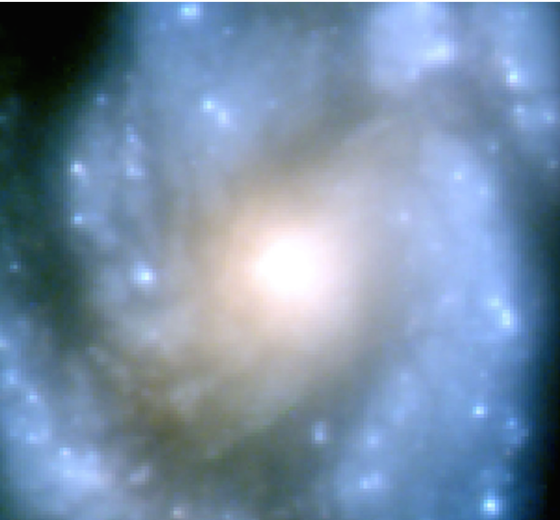
Dataset and Initial Results
NASA Image Of The Day Dataset（from 2015.01.01 up until 2022.10.03.）
  2481 600x600 images
Top 100 Hubble Telescope Images
  100 images taken by the Hubble Telescope
  initial image example:

Slide 4
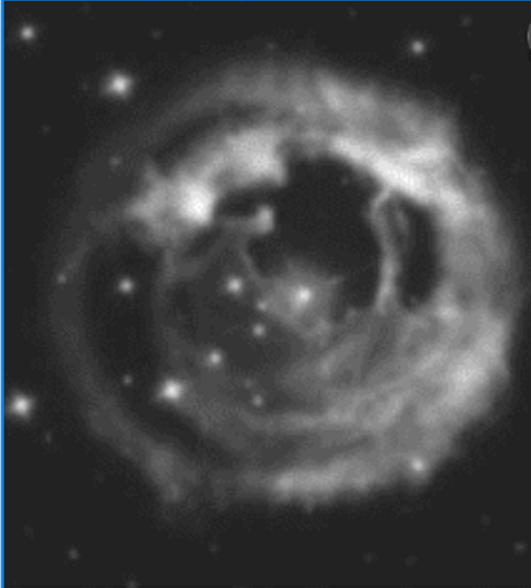
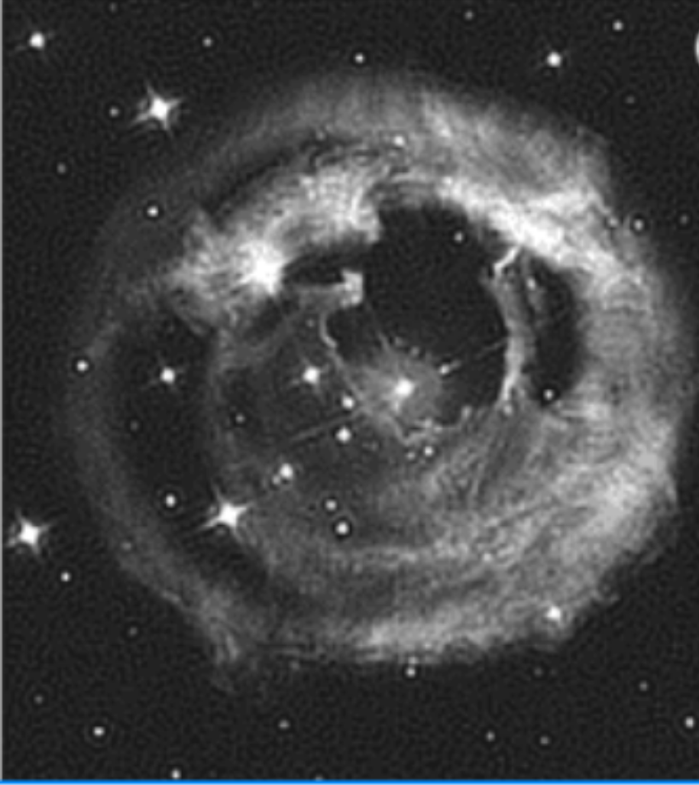
sample ouput of the classical algorithm
The noise is generated from the virtue of wave propagation caused by atmospheric turbulence in the outer space.
The effect of the noise is the blurring phenomenon, as we can see from the left image.
The blurred image is restored by minimizing the second-order central moment (SOCM).
Finally, the restored image is shown on the right hand side, and we can see the obvious improvement.

Slide 5
References
website: www.nasa.gov
www.nasa.gov/multimedia/imagegallery/iotd.html
www.kaggle.com/search?q=astronomy+images
paper: Molina, R., Núñez, J., Cortijo, F. J., & Mateos, J. (2001). Image restoration in astronomy: a Bayesian perspective. IEEE Signal Processing Magazine, 18(2), 11-29.
Zhongming, D. (2016). Research on The Astronomical Image Restoration
Algorithms for Mixed Degradation Mode. Retrieved from https://kns.cnki.net/kcms2/article/abstract?v=3uoqIhG8C475KOm_zrgu4lQARvep2SAkkyu7xrzFWukWIylgpWWcEtOjYRekHLRycerbuxhWZMBnx7mtyyBkeppW0axZd7_9&uniplatform=NZKPT

